Slide 1

Industrial training in game development
00114802719
Shivam chaturvvedi

Slide 2

Game development in unreal engine.
Unreal Engine (UE in short) is a game engine developed by Epic Games, first showcased in the 1998 first-person shooter game Unreal. Initially developed for PC first-person shooters, it has since been used in a variety of genres of three-dimensional (3D) games and has seen adoption by other industries, most notably the film and television industry. Written in C++, the Unreal Engine features a high degree of portability, supporting a wide range of desktop, mobile, console and virtual reality platforms.

Slide 3
– unreal engine 5
Basic information –
the software used is called unreal engine 5.
It gives ability to implement gameplay via code and visual language called blueprints.
It can even create a plugin that modifies or extends engine.
Unreal Engine 5 empowers all creators across all industries to deliver stunning real-time content and experiences.

Slide 4
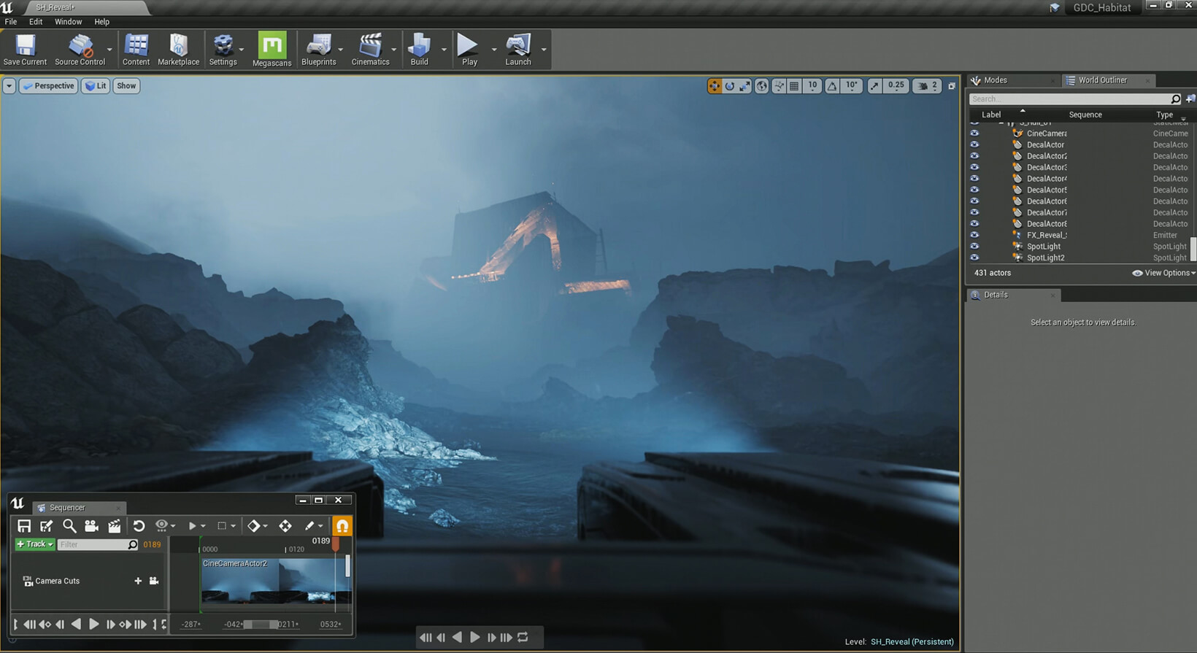
Software use– unreal engine
Unreal Engine is the world's most open and advanced real-time 3D creation tool for photoreal visuals and immersive experiences.
Unreal Engine is free to download. It offer a choice of licensing terms depending on your use of Unreal Engine.

Slide 5
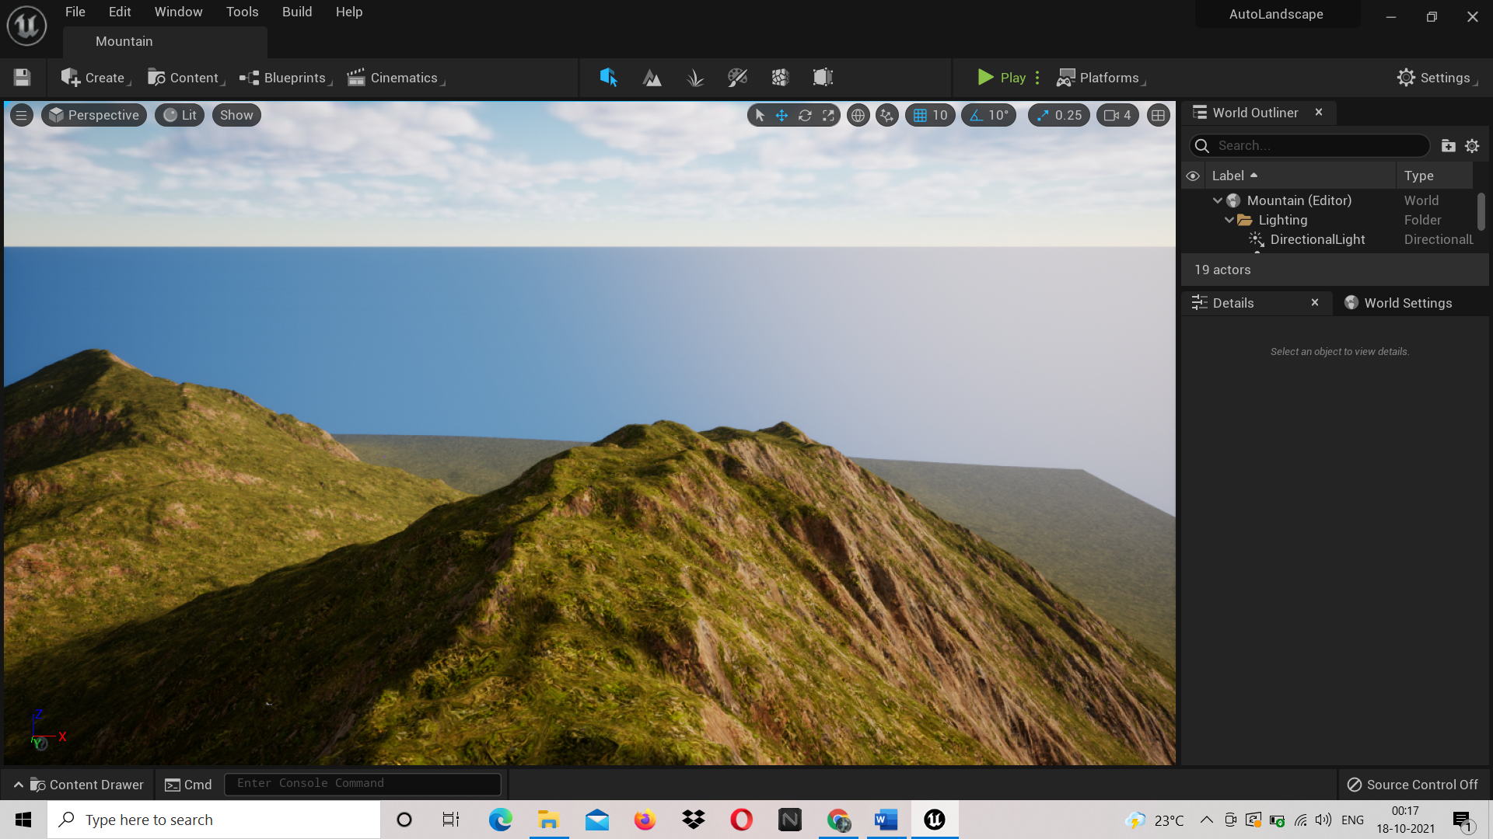
Code and Environment

Slide 6
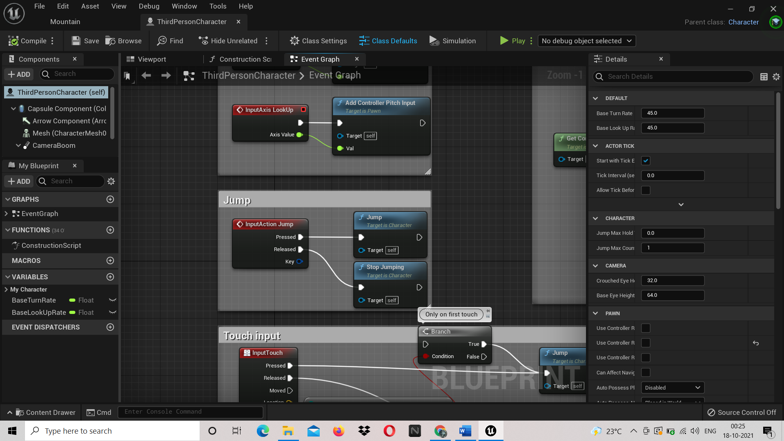
This is called event graph

Slide 7
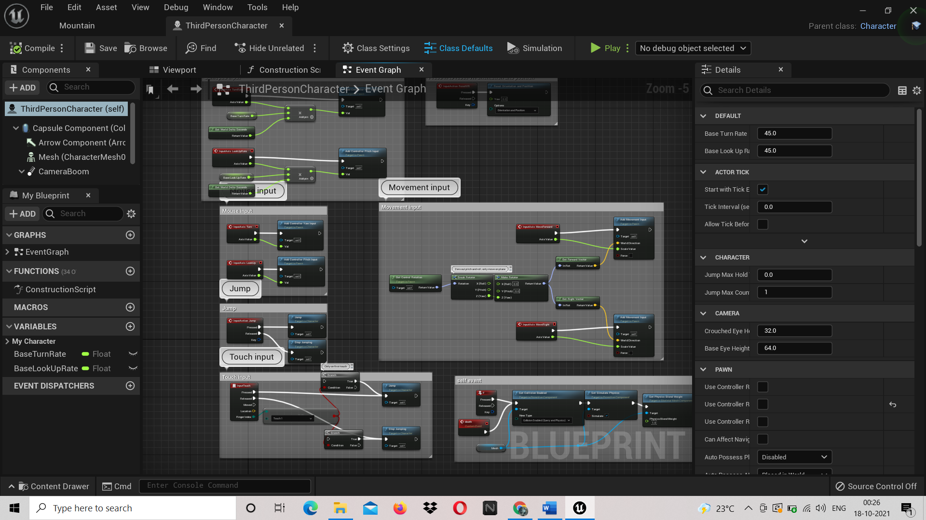
1.These event graphs are used to make characters function and work .
2.There are specific event graph for different meshes and characters .
3.They are also used to design a mesh(object).
4. To add textures, roughness, and change properties like wind .

Slide 8
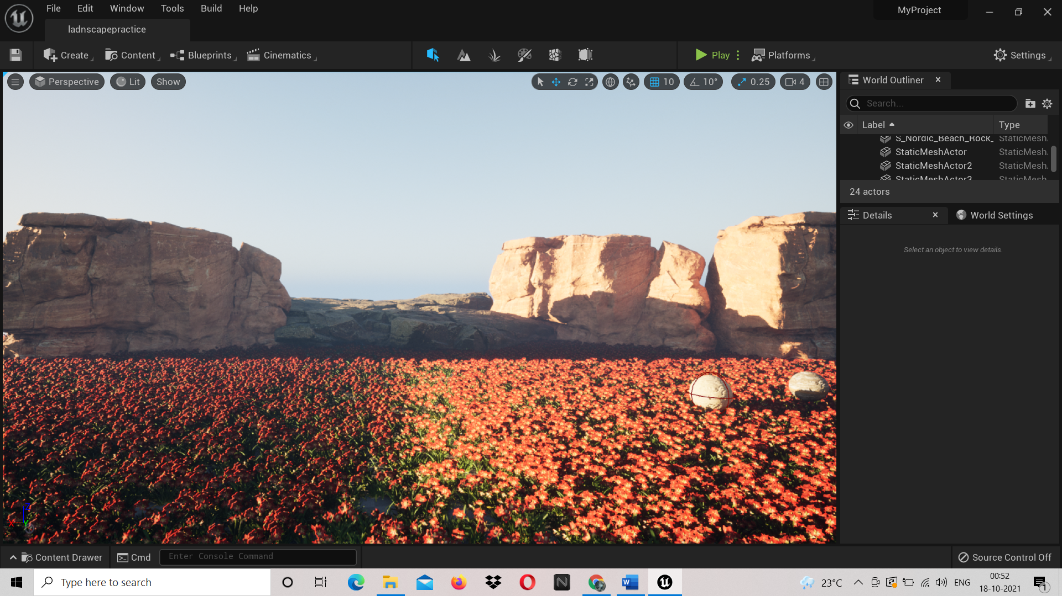
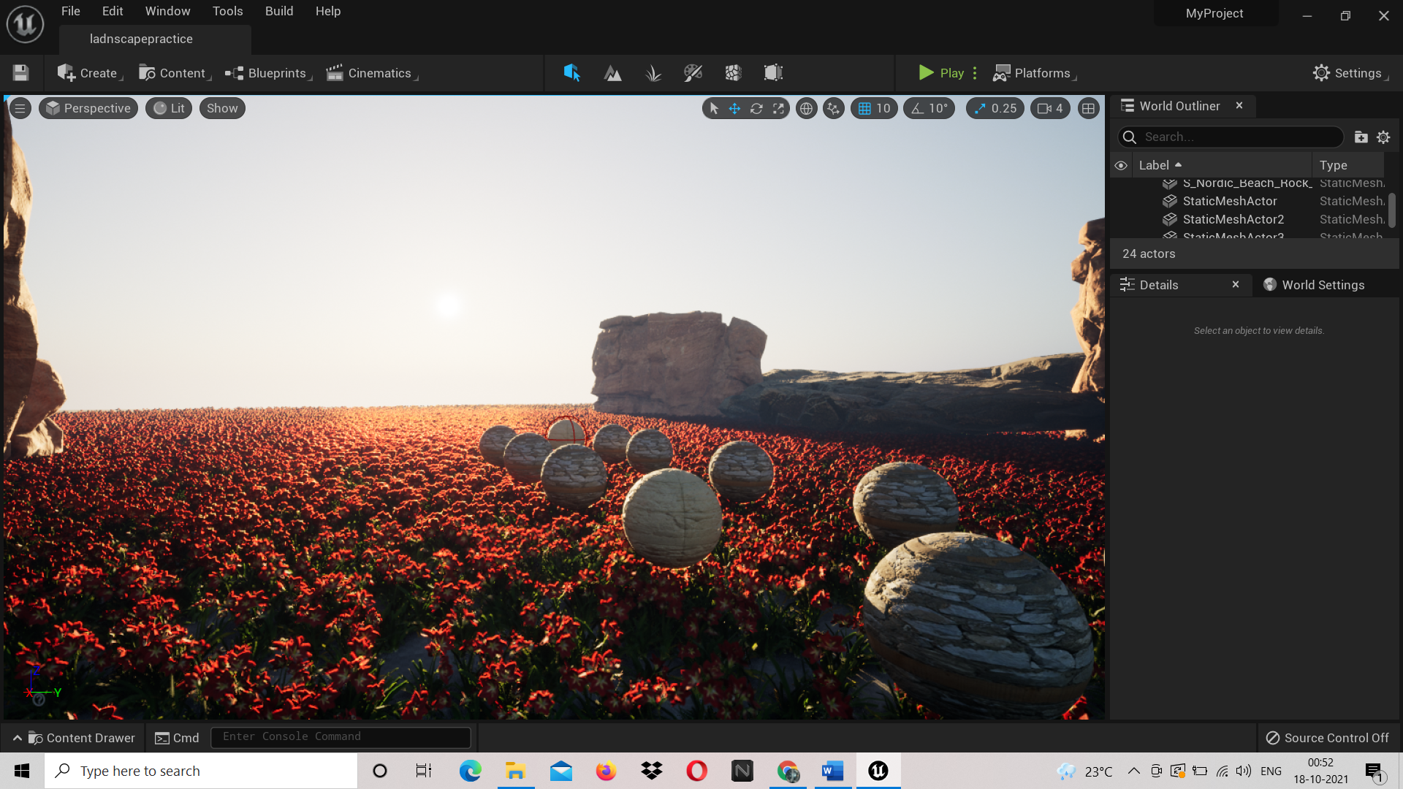
Example environments-

Slide 9
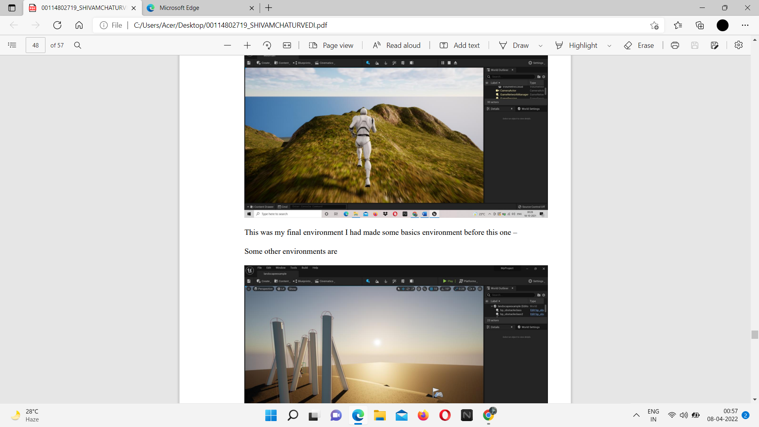

Slide 10
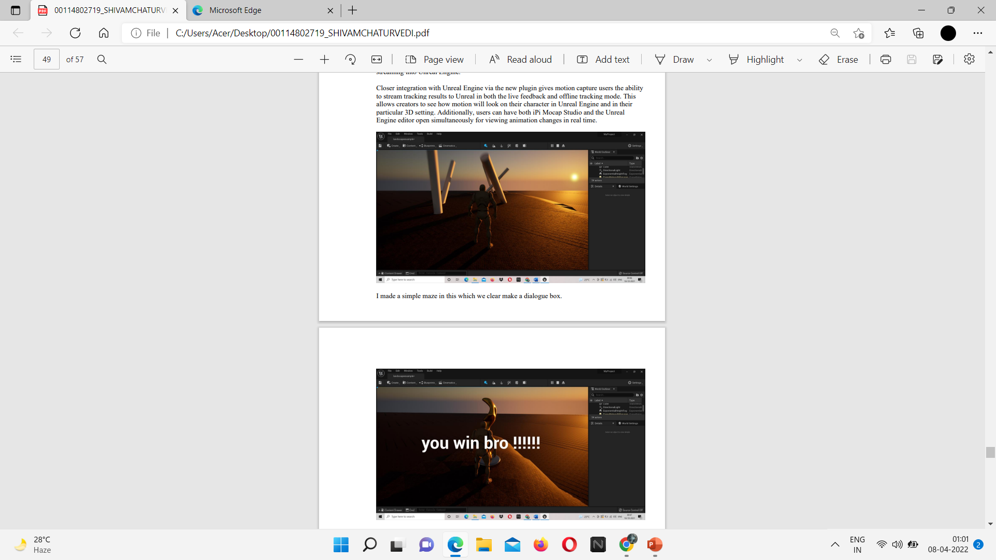

Slide 11
Future Scope-
Game Designing is one of the most upcoming Courses for students who wanted to make a Game Designer Career in India in animation. The gaming industry is rapidly growing at a pace of 50% per annum. There is a very wide and bright future in game design in India.
By 2022, the gaming industry is projected to grow to USD 196 billion. In India, the number of game development companies has grown from 25 in the year 2010 to 275 in 2019, according to a study conducted by KPMG. ... The online gaming industry in India is projected to grow at 22% annually, to reach INR 12,000 crore by 2023.

